Slide 1






Slide 2

R
U
S
T
RUST

Slide 3
R
U
S
T
CONTENTS
INTRO
1.1 Intro
1.2 Cargo
1.3 Application
1.4 Advantages
1.5 Disadvantages
SET UP
EXAMPLES
COMMENT

Slide 4
INTRO
R
U
S
T
Rust is a multi-paradigm system programming language focused on safety, especially safe concurrency. Rust is syntactically similar to C++, but is designed to provide better memory safety while maintaining high performance.

Slide 5
R
U
S
T
INTRO
Rust was originally designed by Graydon Hoare at Mozilla Research, with contributions from Dave Herman, Brendan Eich, and others. The designers refined the language while writing the Servo layout or browser engine, and the Rust compiler.

Slide 6



R
U
S
T
Dave Herman
Graydon
Hoare
Brendan Eich

Slide 7
CARGO
R
U
S
T
Cargo is Rust's build system and package manager. Cargo is similar to Bundler of Ruby, npm of Node.js, pub of Dart, pip of Python,... .ui
Cargo new : create a cargo for desired project.
Cargo build : configure and compile of current cargo.
Cargo run : execute the cargo.

Slide 8
APPLICATION
R
U
S
T
Rust is used to program some types of application as:
Compiler
Web framework
Real-time software
Distributed and parallel computing
Embedded system

Slide 9
ADVANTAGES
R
U
S
T
Rust can work on different platforms and also can be used as a functional, statically typed and system programing language.
Rust is more secure than the language from which it has been inherited. Such as C or C++. Rust focuses more on consistency and better memory safety.

Slide 10
R
U
S
T
ADVANTAGES
Rust requires only the operating systems and no additional software is required for compiling Rust programs.
Rust codes are reusable.
Rust is very good at error handling.

Slide 11
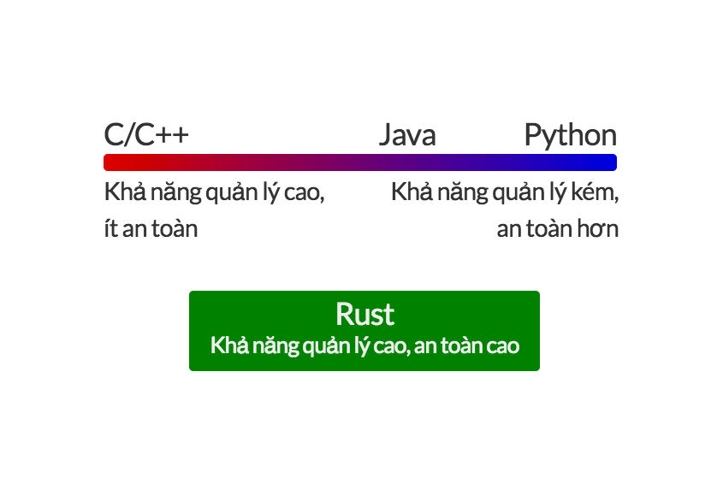
R
U
S
T
ADVANTAGES

Slide 12
DISADVANTAGES
R
U
S
T
There is no garbage collection in Rust.
The Compiler of Rust is very slow compared to the other typical programming language compiler.
In case of scripts which are more than a thousand lines, the compile time may be much higher

Slide 13
DISADVANTAGES
R
U
S
T
In Rust, the codes cannot be developed as fast as can be developed in other scripting languages like Python or Perl.
Since Rust is a system programming languages also, therefore performing simple kinds of tasks also may take lots of understanding and uses of different syntaxes

Slide 14
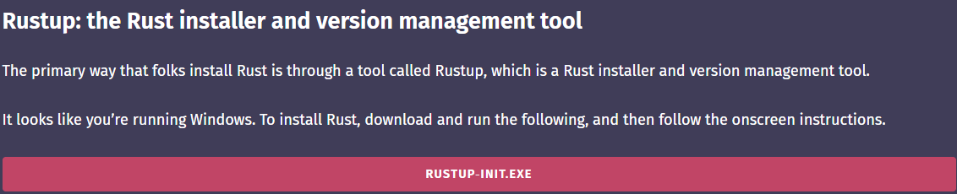
HOW TO SET UP
R
U
S
T
Firstly, we need to download Rustup-init.Exe from the main website. https://www.rust-lang.org/
After that, we install it and installer will appear with command prompt displaying 3 options which you can customize anything you want.

Slide 15
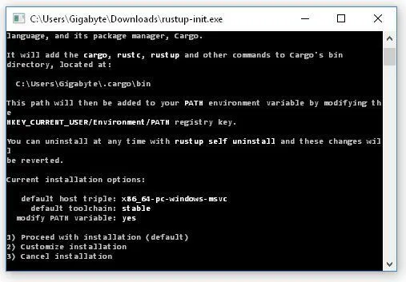
R
U
S
T
HOW TO SET UP

Slide 16




R
U
S
T
visual code
vim
sublime
text 3
eclipse

Slide 17




R
U
S
T
emacs icon
geany icon
intellij idea
atom

Slide 18
R
U
S
T

Slide 19
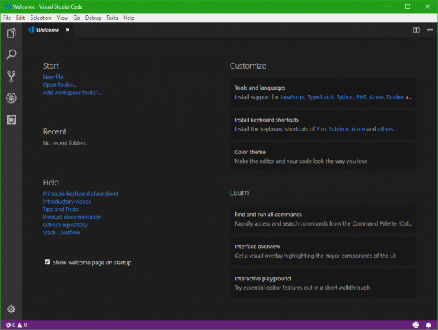
R
U
S
T

Slide 20
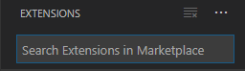
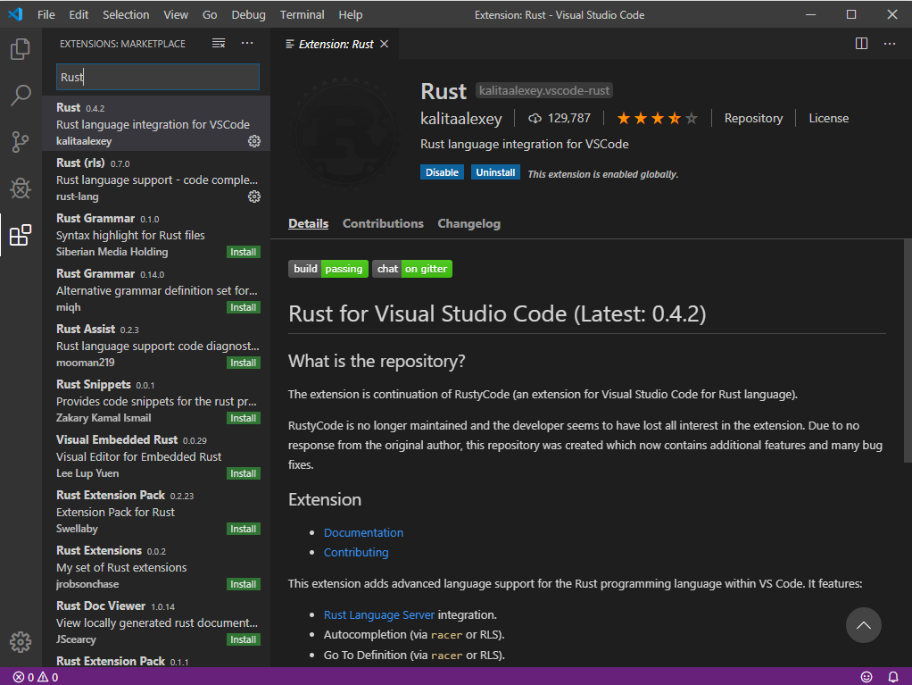
R
U
S
T

Slide 21
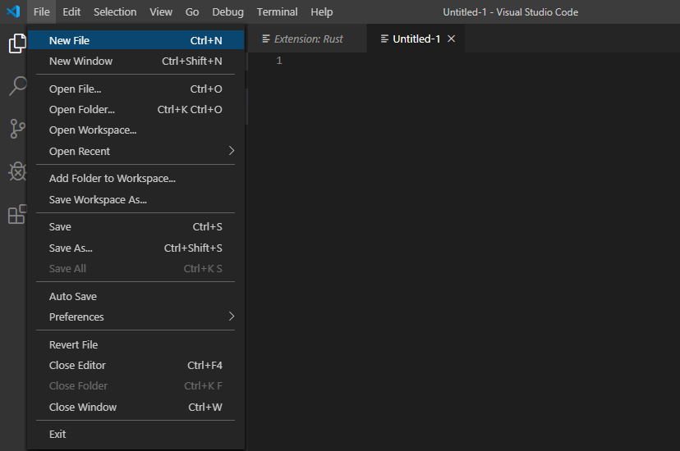
First Program/Hello World
R
U
S
T

Slide 22
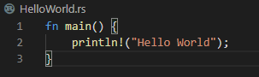
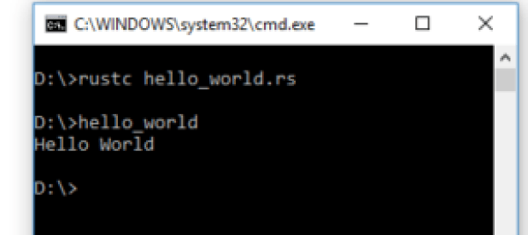
R
U
S
T

Slide 23
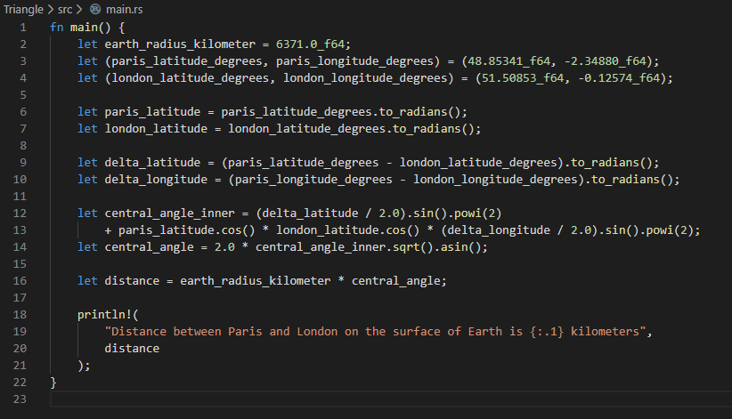
Examples1
R
U
S
T

Slide 24
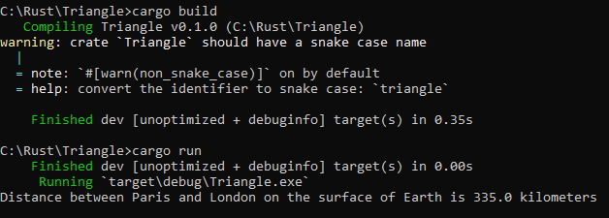
R
U
S
T
Examples 1

Slide 25
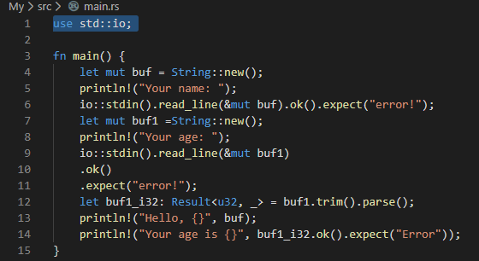
R
U
S
T
Examples 2

Slide 26
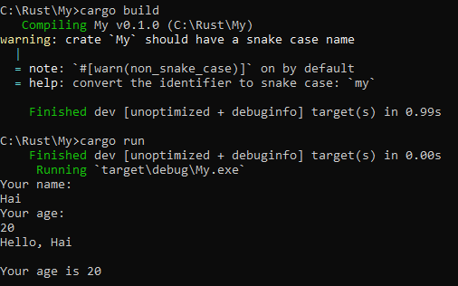
R
U
S
T
Examples 2

Slide 27
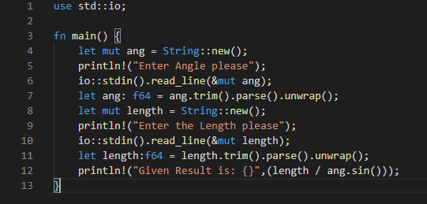
R
U
S
T
Examples 3

Slide 28
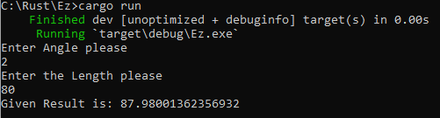
R
U
S
T
Examples 3

Slide 29
COMMENT
R
U
S
T
Even though Rust was established in 2010, it has become the most beloved language mainly by the veteran programmers, even some only just begins to learn this language. Mainly because of its speed to compile and being a safe language.
Rust has been the "most loved programming language" in the Stack Overflow Developer Survey every year since 2016

Slide 30
COMMENT
R
U
S
T
However due to being a new language, some of its functions when compare to C/C++ or Javascript like syntaxes, are still limited. Neither does the garbage collection. Rust is being improved by contributors with feedbacks and opinions.
Overall if you are looking for the language that guarantees safetiness and high management, Rust is the one for you.

Slide 31
R
U
S
T
REFERENCES
https://www.rust-lang.org/
https://chercher.tech/rust/introduction-rust?fbclid=IwAR3aarOhaLhnEJKxRRyJUgw72soyQyvpdKvGwHta04NVYHvEBke8Ucuum9w
https://phocode.com/rust-lap-trinh-rust/
https://rust-lang-nursery.github.io/rust-cookbook/

Slide 32

Trần Anh Quân
Phùng Tuyền Hào
Nguyễn Ngọc Đức

